Slide 1

Plenary
15 minutes

Slide 2


In Crisis: Danger and Opportunity
危機
SamGuckenheimer

Slide 3

We are experiencing a once-in-a-century crisis

Slide 4


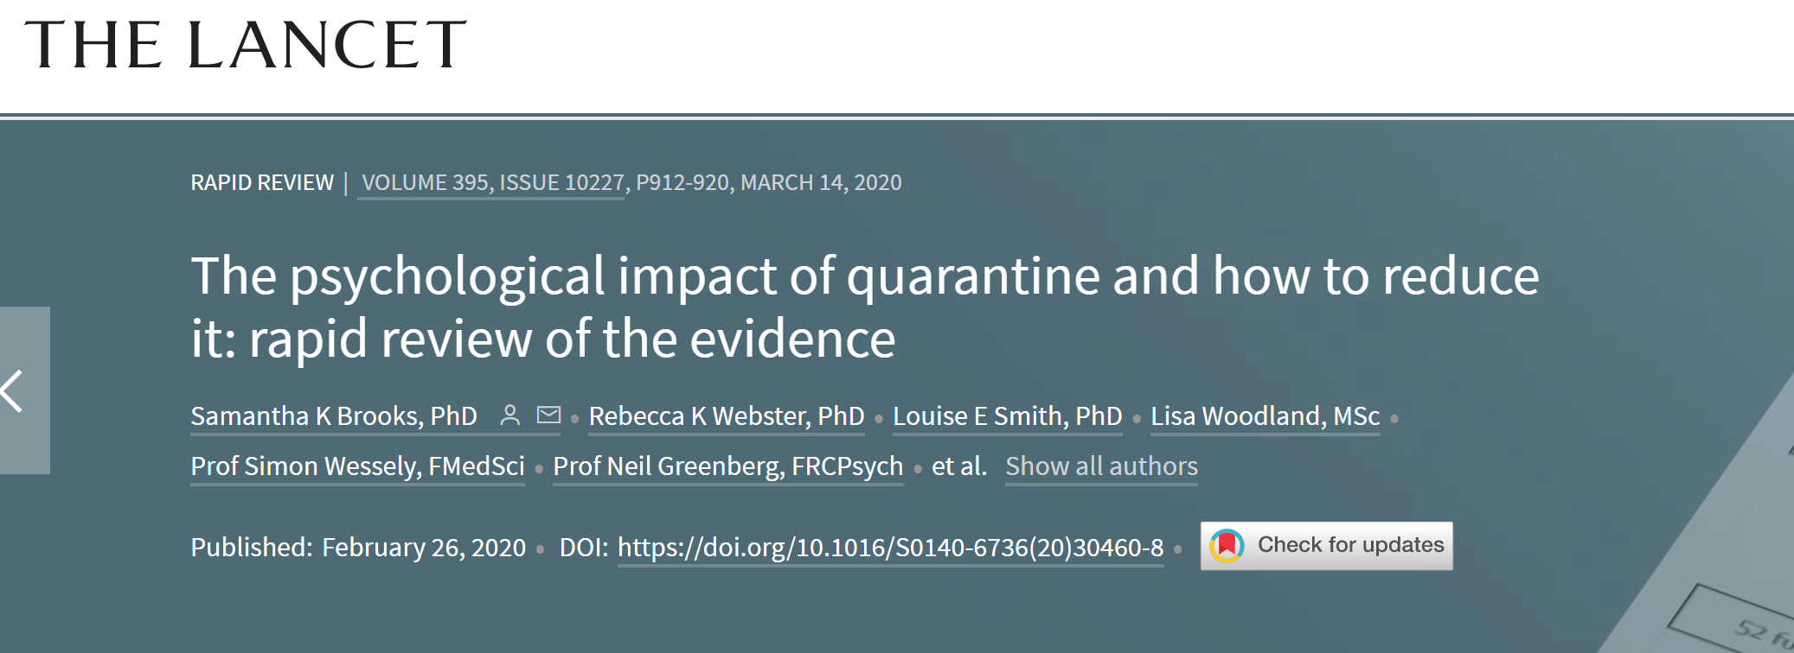
Quarantine During Pandemic
“Most reviewed studies reported negative psychological effects including post-traumatic stress symptoms, confusion, and anger.”

Slide 5
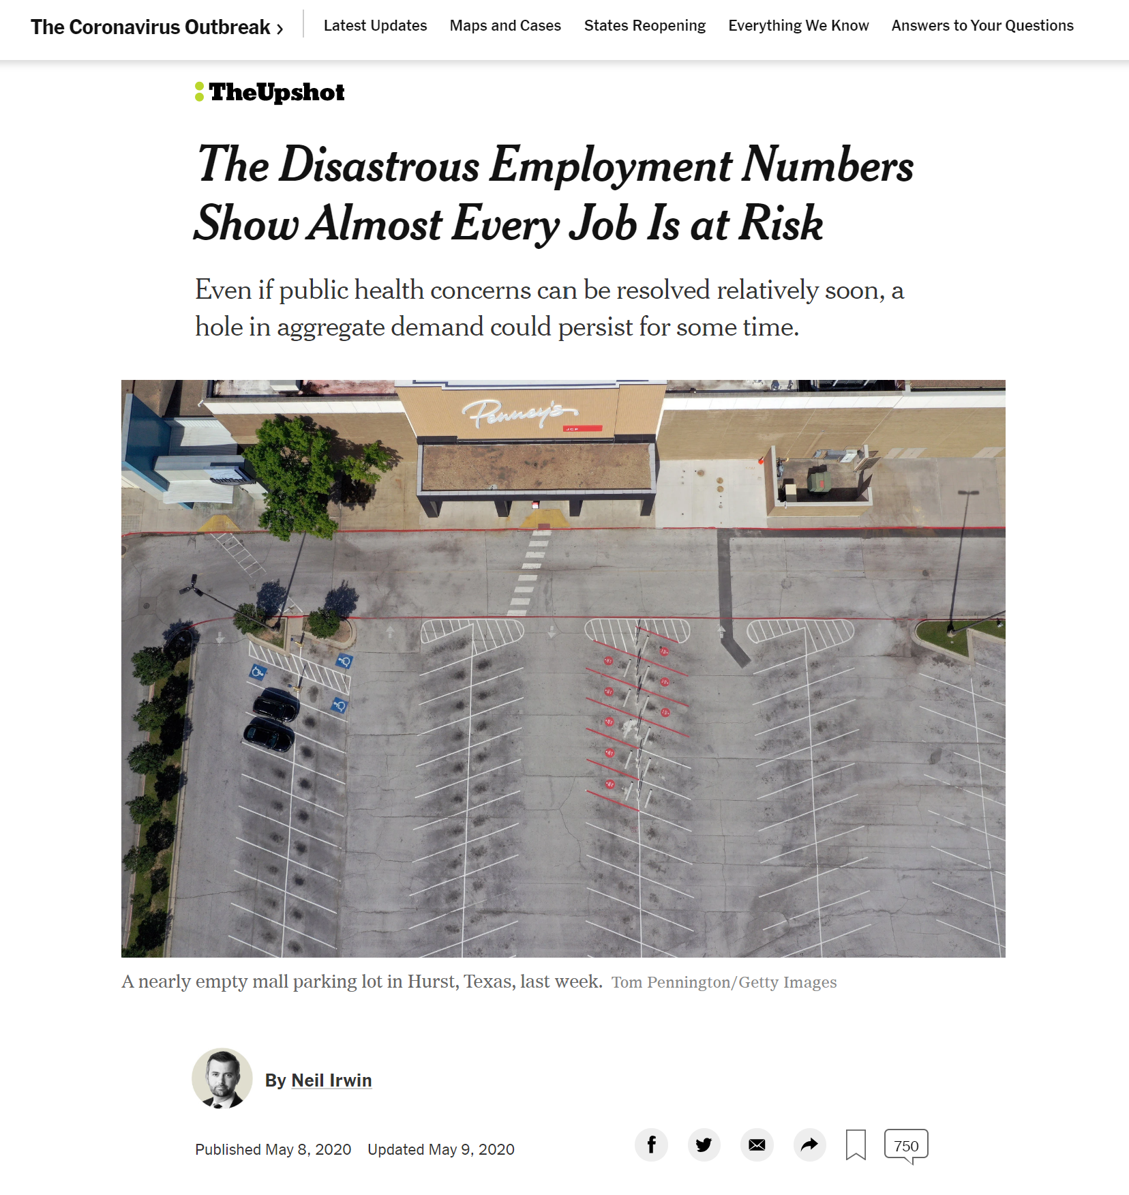

43%
of jobs may not return

Slide 6


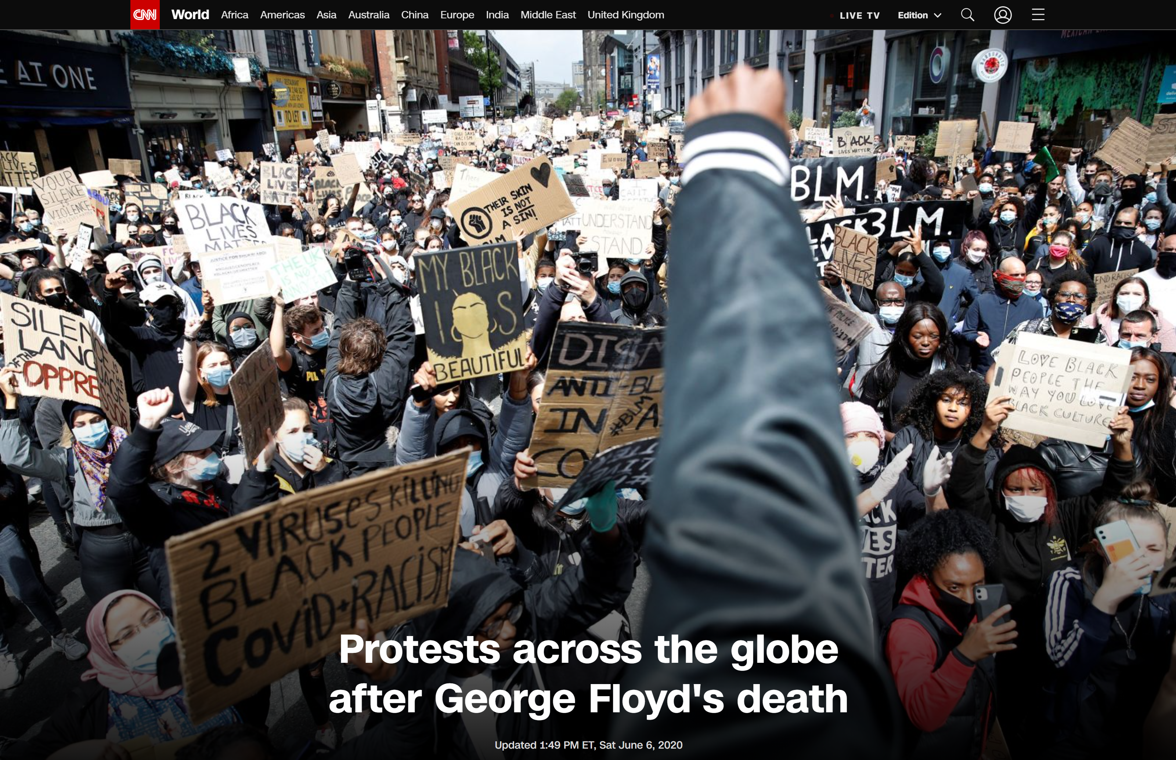
Worldwide calls for social reform
Manchester, England
Saturday 6th June

Slide 7
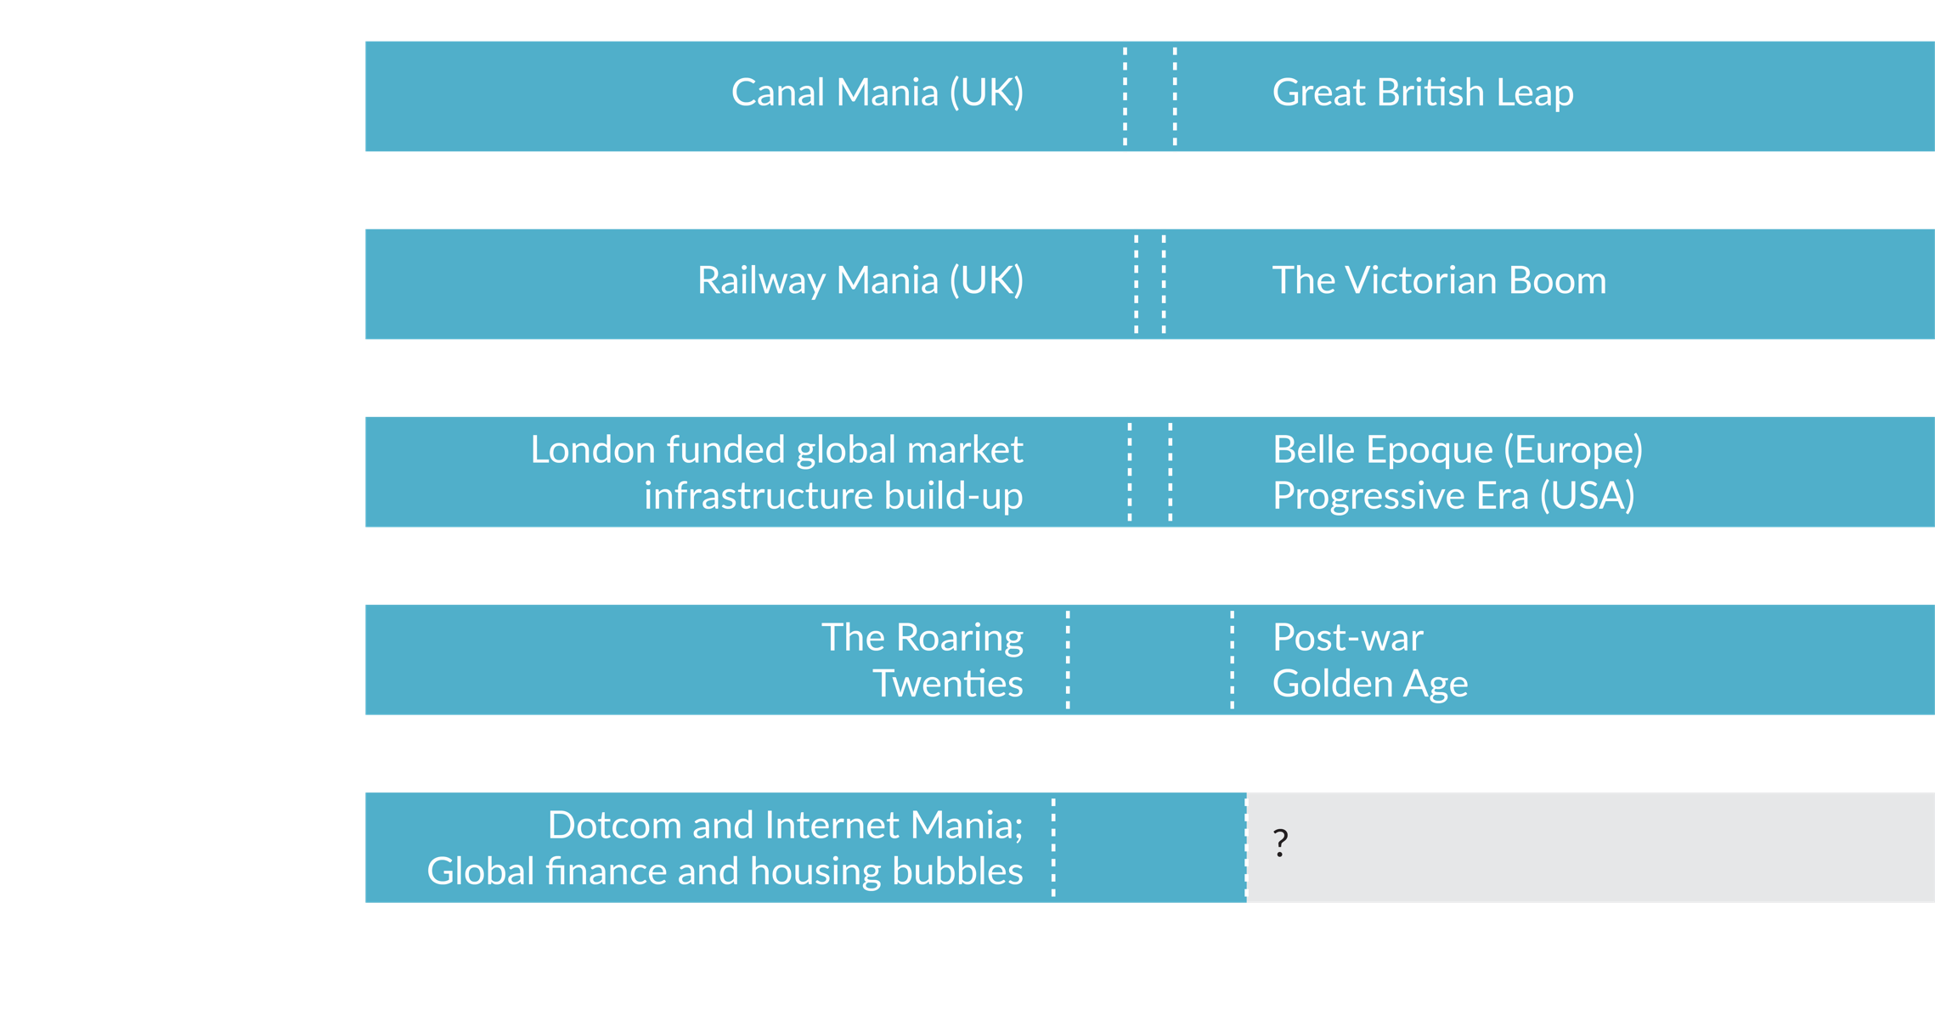

Technological Revolutions
Factory systems
Subcontracting
Taylorism
Fordism
You are here
@mik_kersten
projecttoproduct.org
Figure: Adapted from Carlota Perez
Notes:
USING SOMETHING FROM 2 AGES AGO
The problem is, most companies established prior to the start of the Age of Software are using managerial techniques from past ages. They are applying project management, a technique good for building the hoover dam and data centers, to software innovation. And it doesn’t work, no more than Gantt charts do for measuring the value delivered by a car production line.
Leadership wants to succeed, but does not have the right framework to manage IT software delivery, which is rapidly becoming the highest cost for most organizations.
So how did others do it? How did the successful car companies we have today make it through the last turning point?
To seek an answer to this question, I did a tour of one of our customers who is in the middle of an impressive digital transformation. But instead of going to the IT center as usual, my colleage Rene who is speaking [tomorrow] took on a 2 day tour of BMW’s flagship plant.
---------
Using managerial frameworks from the last ages, like project management
Tracking activities, not results

Slide 8

The Turning Point
Creative
Destruction
Wealth Generation
Digital, Cloud, Remote during Pandemic, Depression, Inequality
Figure: Adapted from Carlota Perez
Notes:
Tech giants have already solved this problem
Wealth generated by Tech Giants dwarfed by those that survive the turning point.
Best is yet to come
At the start each age we have a financial capital frenzy, driven by Venture Capital in this one. In the Age of Oil and Mass production, there were over 300 car startups in Detroit. We now recently seen over 2000 fintech startups attacking every part of the banking experience. Then, in the turning point, there is a shift to production capital, to the companies like Apple and Amazon who become the new [railroad barons] and through this turning point force a mass extinction.
For this Age, companies who become masters of software at scale have a shot at making it through the Turning Point. The ones who move too slowly will decline as the new Production Capital takes over.
Wealth that will be generated by the current Tech Giants will be dwarfed the by the wealth generated by those that survive the turning point. That’s opportunity. That’s how we thrive
-----------
https://www.cbinsights.com/research/report/hardware-startups-failure-success/
Tech giants already have connected Value Stream Networks
Google: 2B LOC
Not just a question of technical practices
Increasing disruption by tech giants. W e can turn the tide. But how.
We need a new framework.
Notes
Jawbone: $930M of funding

Slide 9

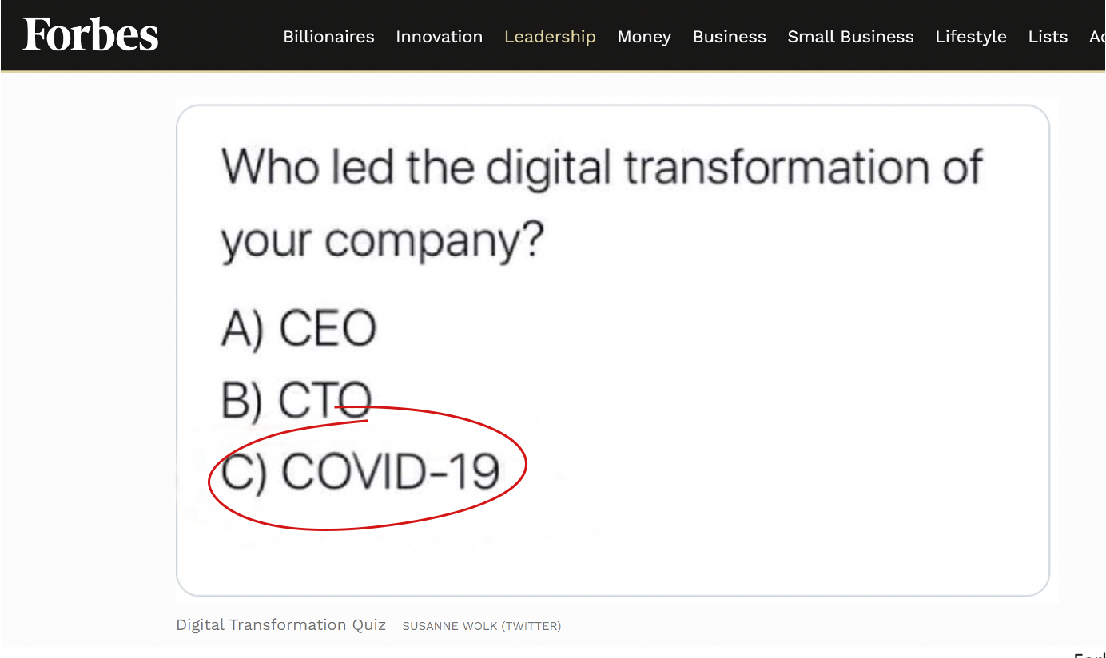
Leadership Crisis Inside the Crisis
Forbes, 4/5/20

Slide 10
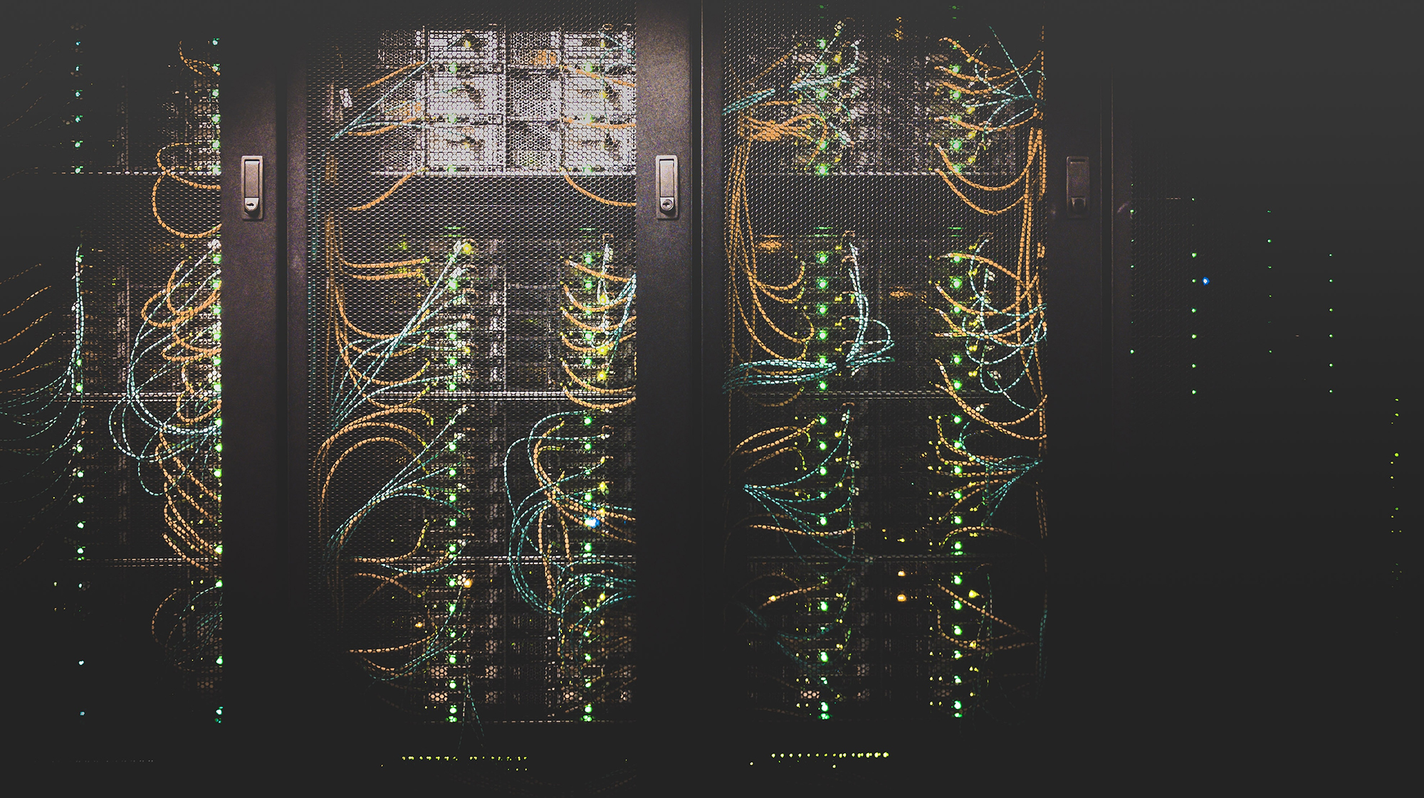
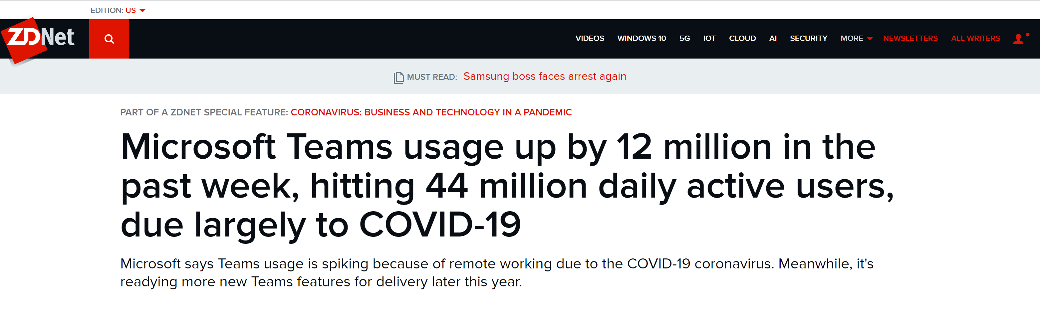
The Internet and Cloud have Scaled
Notes:
Teams video call minutes increased 100x in March

Slide 11

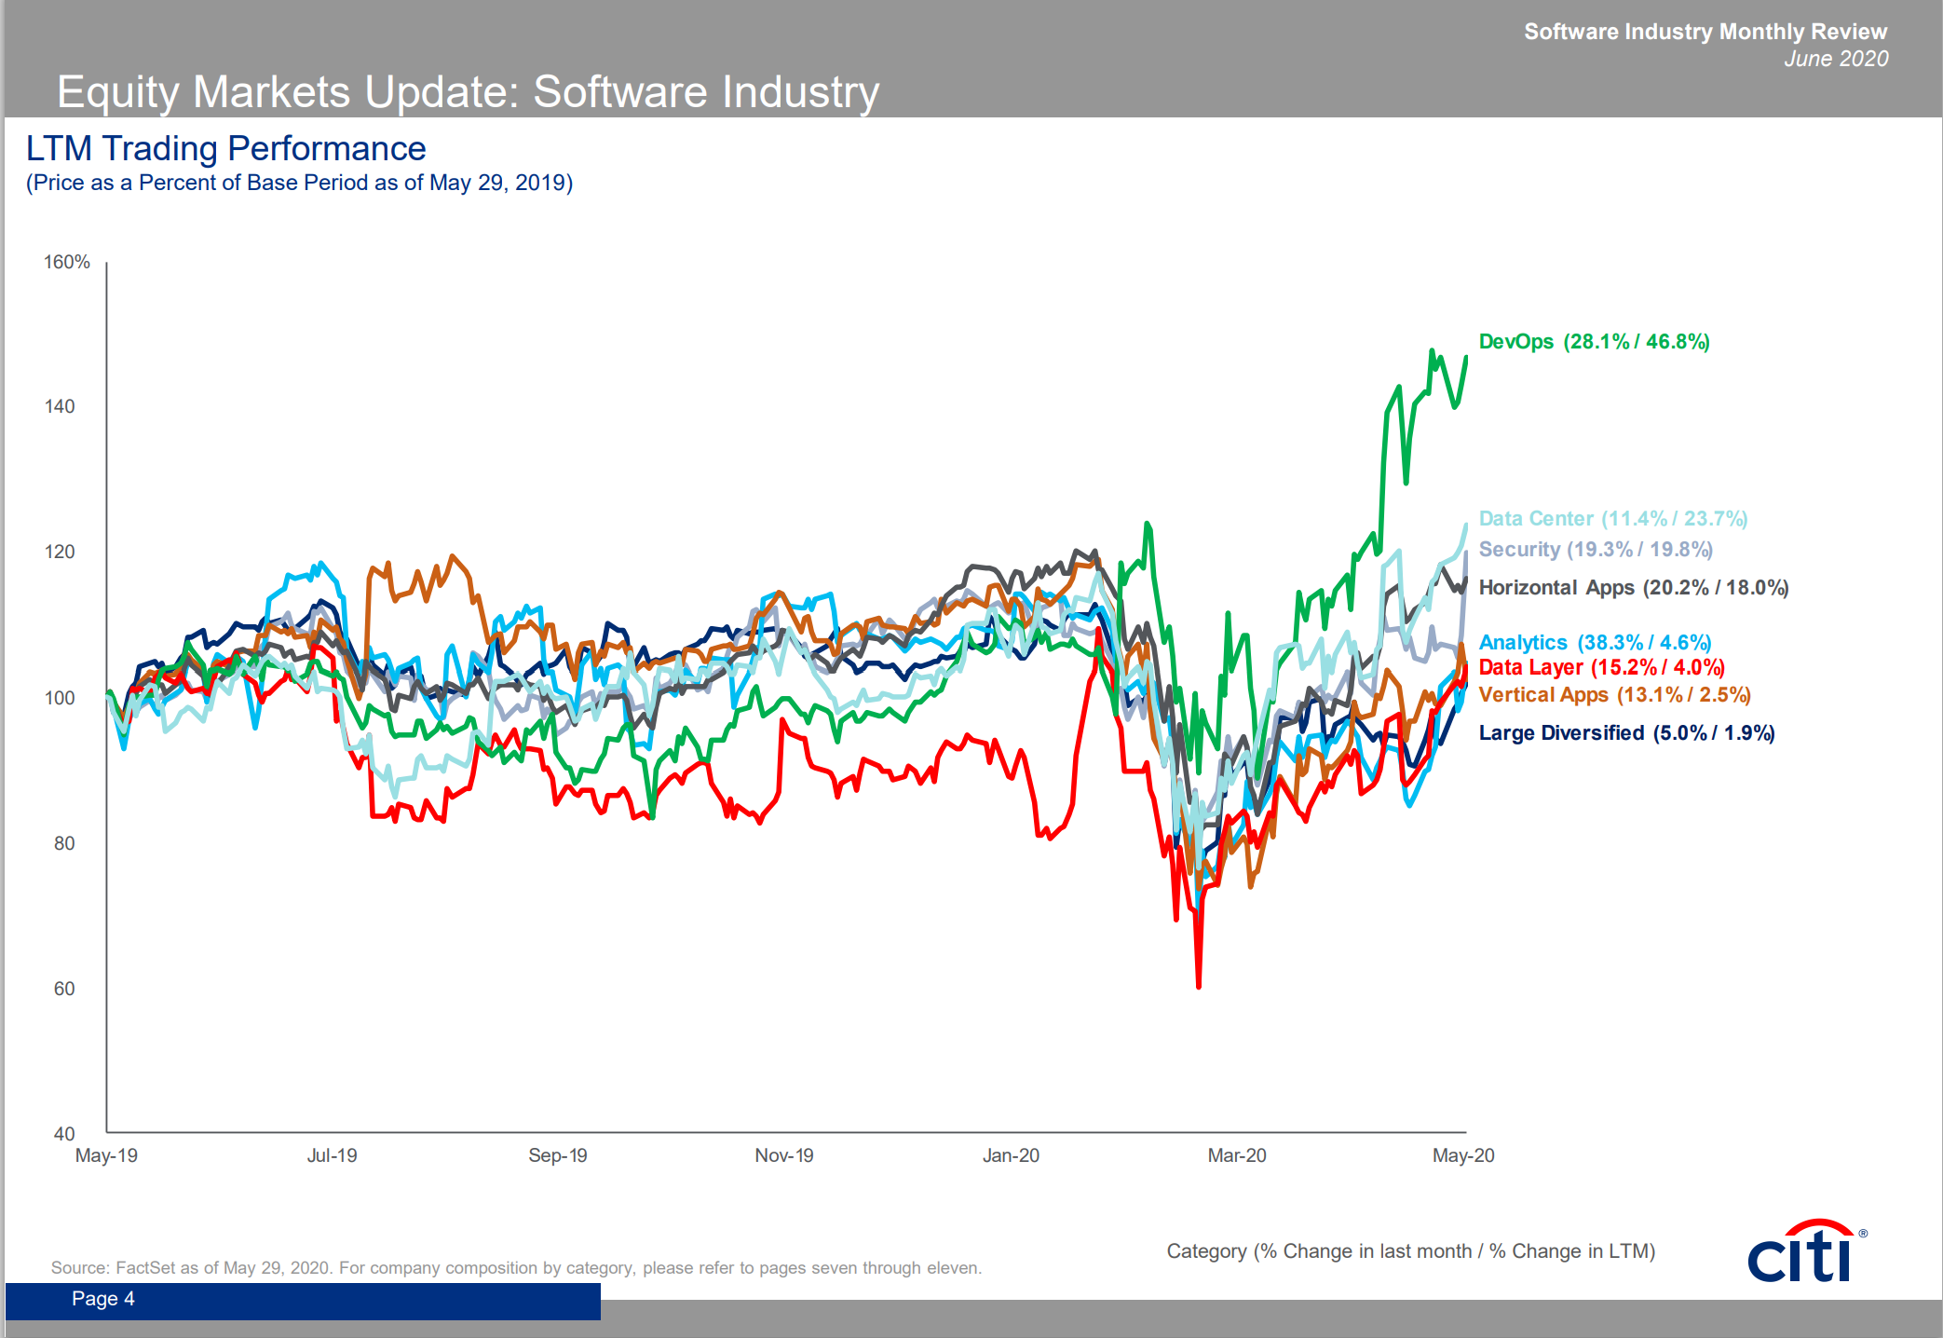
Remote Work ❤️ DevOps
Market returns now recognize the advantage
Source: citi Software Industry Monthly Review June 2020

Slide 12




Work-from-Home Coverage in US Newspapers Increased 120x in March 2020
March 10th ≈
Start of COVID lockdown
Source: Newsbank Access World News collection of approximately 2000 national and local daily US newspapers. Shows the % of articles mentioning “working from home” or “WFH”.
Marissa Mayer at Yahoo recalls a working-from-home team to the office, Feb 22nd 2013
Mitch McConnell and Rand Paul working from home due to injuries

Slide 13

Employees Want to Keep Working from Home
Post COVID, employees want to increase WfH from 5% to 40%,of working days
Employers are planning only about 20%
Methods
N = 2500 US working adults + 1000 Firms
Actual: “In 2019 (before COVID) how often did you have a paid day working from home?”.
Desired: “In 2021+ (after COVID) how often would you like to have paid work days at home?”
https://www.frbatlanta.org/blogs/macroblog 28 May 2020

Slide 14
Mass Work from Home is Here to Stay
Research paper:
The Future of Work: Work from Home Preparedness and Firm Resilience During the COVID-19 Pandemic
[F]irms with high WFH index values have higher stock returns, lower return volatility, and better financial performance during the pandemic. …Contrary to conventional wisdom, our results hold primarily in non-high-tech industries.
2 Jun 2020
John (Jianqiu) Bai, Northeastern University - D'Amore-McKim School of Business
Wang Jin, Massachusetts Institute of Technology (MIT)
Sebastian Steffen, MIT Sloan School of Management
Chi Wan, University of Massachusetts Boston

Slide 15
After the Crisis, There Will Be a New Normal
Strivers
Will blame the pandemic
Value prediction over outcome
Want to restore status quo ante
Thrivers
Will hit refresh
Value learning over prediction
Get stronger under stress
Invest in core, divest in context
Embrace DevOps for Agility
Work in Remote & Hybrid settings
Adapt on the Edge of Chaos

Slide 16
We’re Conducting 30 Studies on the Future of Work
Come to my breakout to dive into the findings
Follow my Twitter for announcement of Remote Engineering Virtual Summit
SamGuckenheimer

Slide 17
Thank you!
Sam Guckenheimer
samgu@microsoft.com | @SamGuckenheimer | http://aka.ms/devops

